Slide 1

NERD GUIDE TO NEW YORK CITY

Slide 2
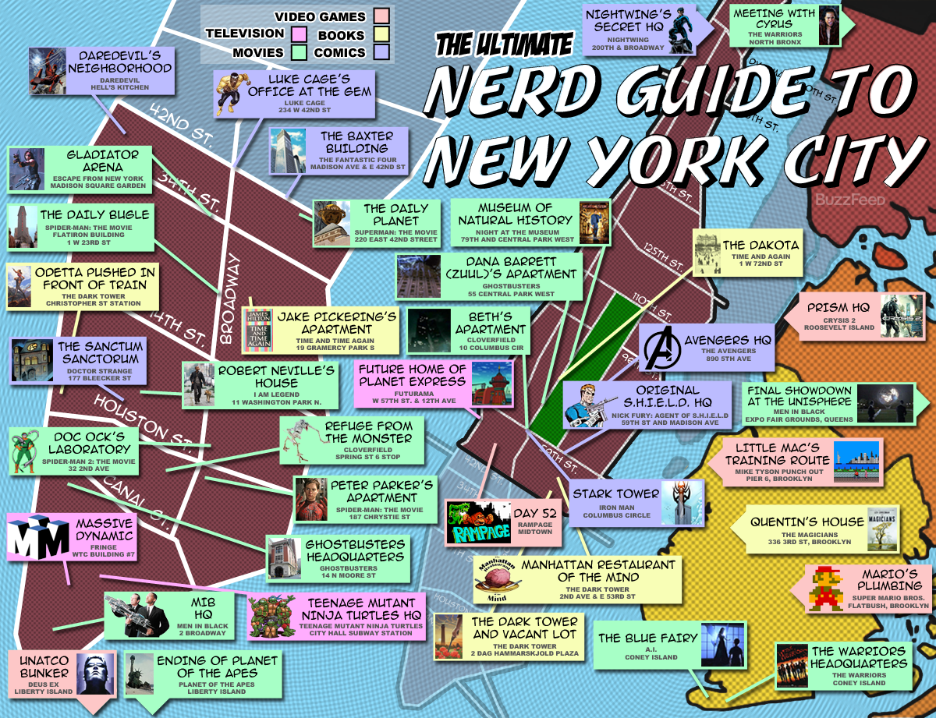

Slide 3
Introduction
Although traveling is a pure joy, preparing it is full of agony
Visiting New York City on a budget might sound a bit far-fetched for some travelers, but with a little careful planning, you can have a successful trip to NYC on any budget.
While New York City is known to be one of the world’s most expensive cities, there are plenty of ways to have an incredible trip without breaking the bank. One of my favorite ways to explore city, venues, budget hotels is always through checking with Foursquare

Slide 4
Aim: This project is aimed to make your travel experience to New York Simple by Providing all nearby locations, local areas, hotels, best places to visit in new York with help of Foursquare datasets.

Slide 5
Overview of How it Works:
Foursquare API provides great amount of quality data’s about locations.(cafe, restaurant etc)
Using this data will allow tourists to easily decide where to go when they are in a specific city.

Slide 6
OBJECTIVES:
First of all, the geojson data for each city’s neighborhood is required.
Then, analyzing the data using the Foursquare API.
Use clustering to identify each area and its category.

Slide 7
GEOGRAPHICAL DATA (Data frame)

Slide 8
RESULT
Using techniques such as K-means clustering, I was able to get results about common venues in city.
This information can be really helpful to tourists since they can focus on what they are trying to experience most during their Travel .(Food, culture, sport etc)
These techniques also provides the visualization of clustering of city.

Slide 9
Results of common venues of New York city

Slide 10
Clustering Of New York City

